Slide 1
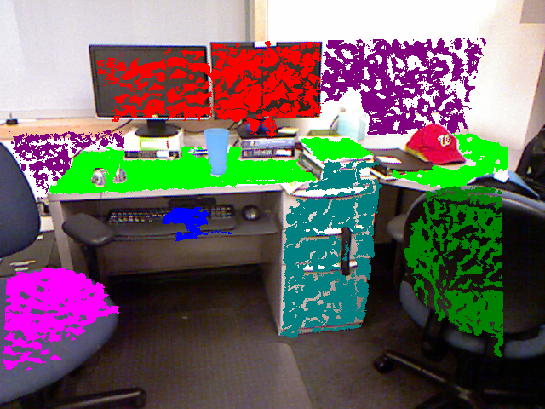
Semantic indoor object identification and
labeling using RGB-D camera

Slide 2
Introduction
We consider the problem of high level scene understanding for personal robots. It includes object detection, labeling of meaningful regions from 3D reconstruction.
The task is to detect commonly found objects in the 3D point cloud of indoor scenes obtained from such cameras. Our method comprises of following features :
combine scene categorization,
geometric layout and
object detection for better scene understanding.

Slide 3
Improvement
3D layout or depths have been used for improving object detection.
3D scene is inferred from a single 2D image.
Point cloud.
3D data - we can more precisely determine the shape, size and geometric orientation of the objects, and several other properties and therefore capture much stronger context.
RGB-D ( Kinect-style) depth cameras - colour and depth can be obtained and helps in providing shape features for object detection ,3D segmentation.

Slide 4
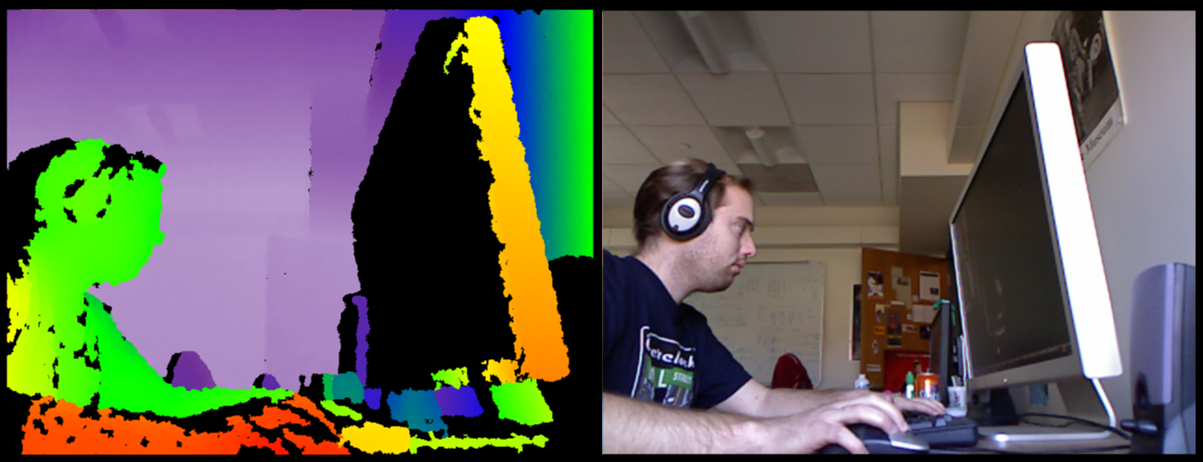
RGB-D Data
Depth Information

Slide 5
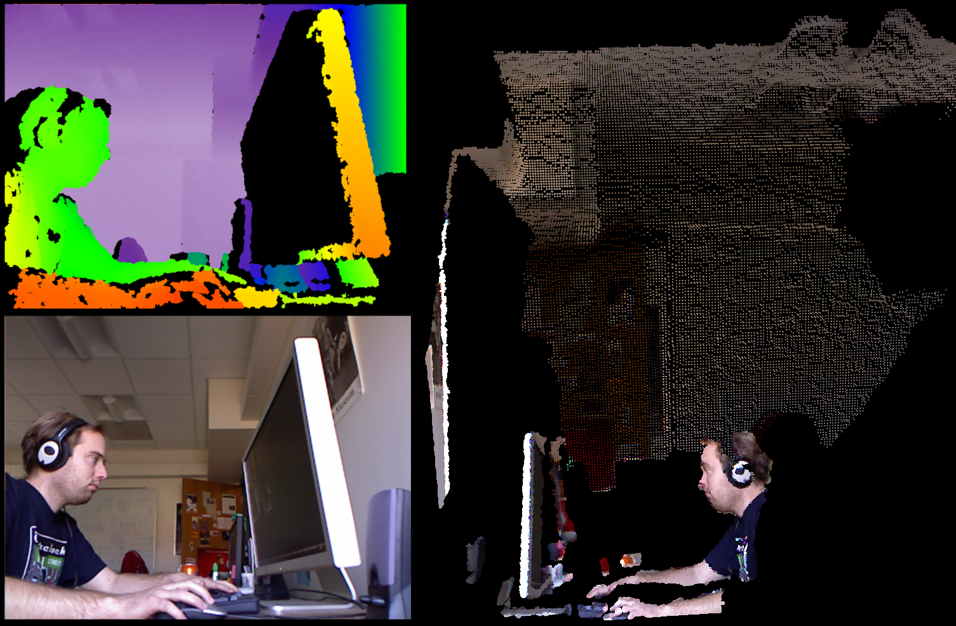
Point Cloud

Slide 6
Approach
Training phase
Capture the images of the objects to be trained from various angles
Use the pass filter to eliminate the area around the object of interest
Use the Euclidian clustering algorithm to form a cluster of points which belong to the object
Determine the features of the cluster which represents the object and save it to the disk in form of a tree.
Testing phase
Capture the image of the set of objects from which the concerned object is to be identified.
Use the Euclidian clustering algorithm to form a cluster of points where each cluster is a distinct object
Determine the features of each and every cluster
Find the nearest neighbor of the clusters feature value in the tree
Now assign the object a label of nearest neighbor.

Slide 7
Requirements
Hardware
RGB-D Camera(Microsoft Kinect)
Software
Point Cloud Library
Kinect drivers

Slide 8
PCD(Point Cloud Data) format :
Point Cloud represents the base class in PCL for storing collections of 3D points.
PCD is used to support 3D point cloud data.
The PCD file format is not meant to reinvent the wheel, but rather to complement existing file formats that for one reason or another did not/do not support some of the extensions that PCL brings to n-D point cloud processing.
k-Nearest-Neighbour classifiers :
It is a non-parametric method used for classification and regression. In both cases, the input consists of the k closest training examples in the feature space. The output depends on whether k-NN is used for classification or regression
In k-NN classification, the output is a class membership. An object is classified by a majority vote of its neighbours, with the object being assigned to the class most common among its k nearest neighbours.
In k-NN regression, the output is the property value for the object.

Slide 9
Implementation

Slide 10
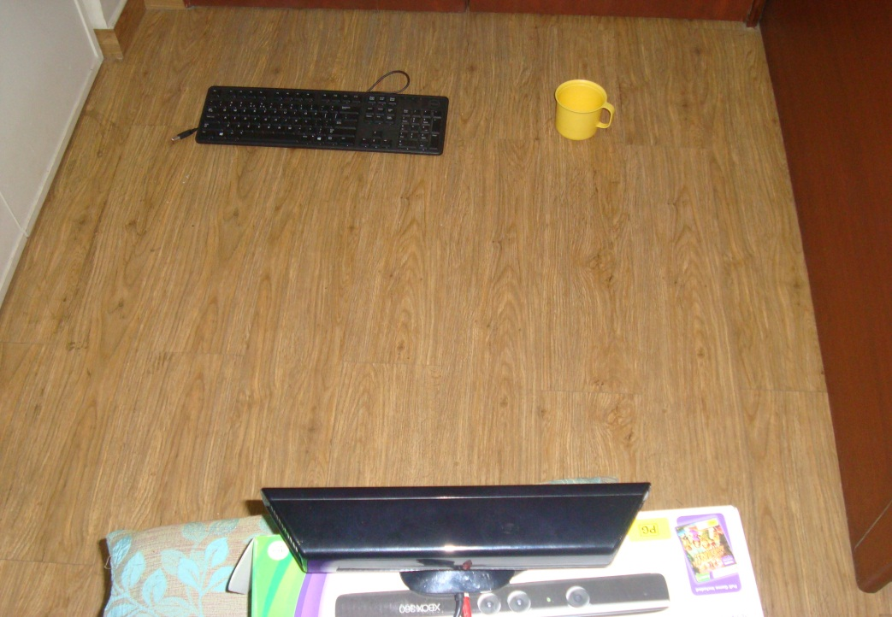
Step 1 :Kinect capturing the objects in order to identify and label them (Setup)

Slide 11
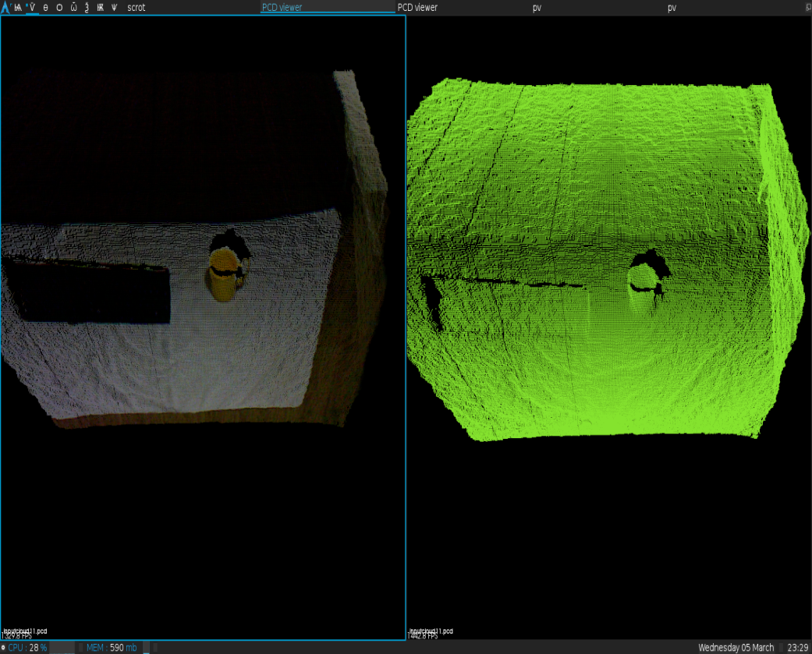
Step 2 :Colored Information captured by Kinect(LHS) Depth Information captured by Kinect(RHS)

Slide 12
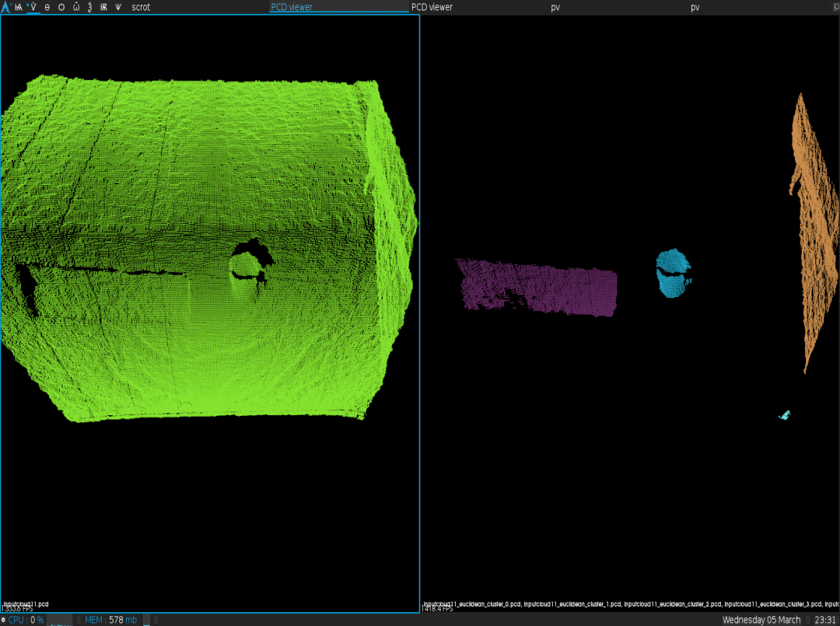
Step 3 :Objects segmented from the input image (Right side)

Slide 13
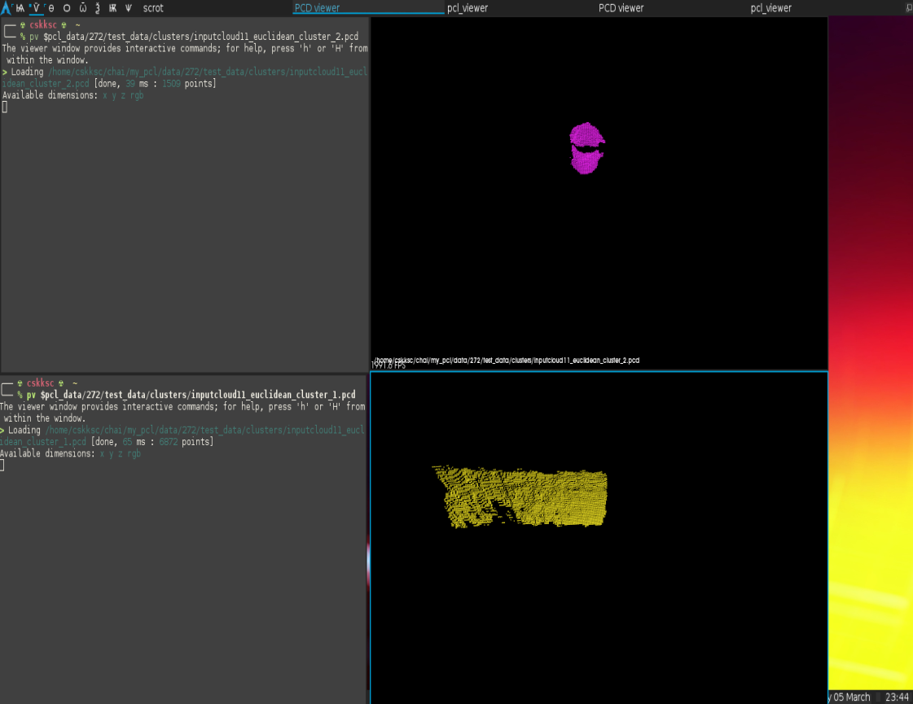
Step 4 :Individual segmented Objects saved in memory

Slide 14
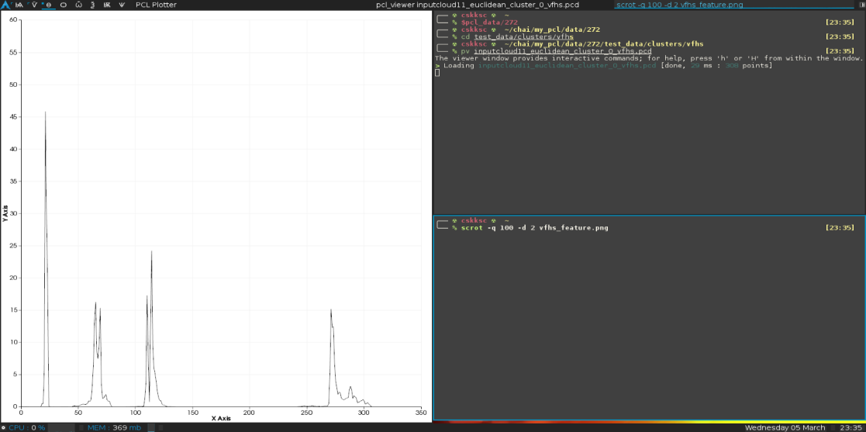
Step 5 : Feature of each individual segment extracted and represented on left

Slide 15
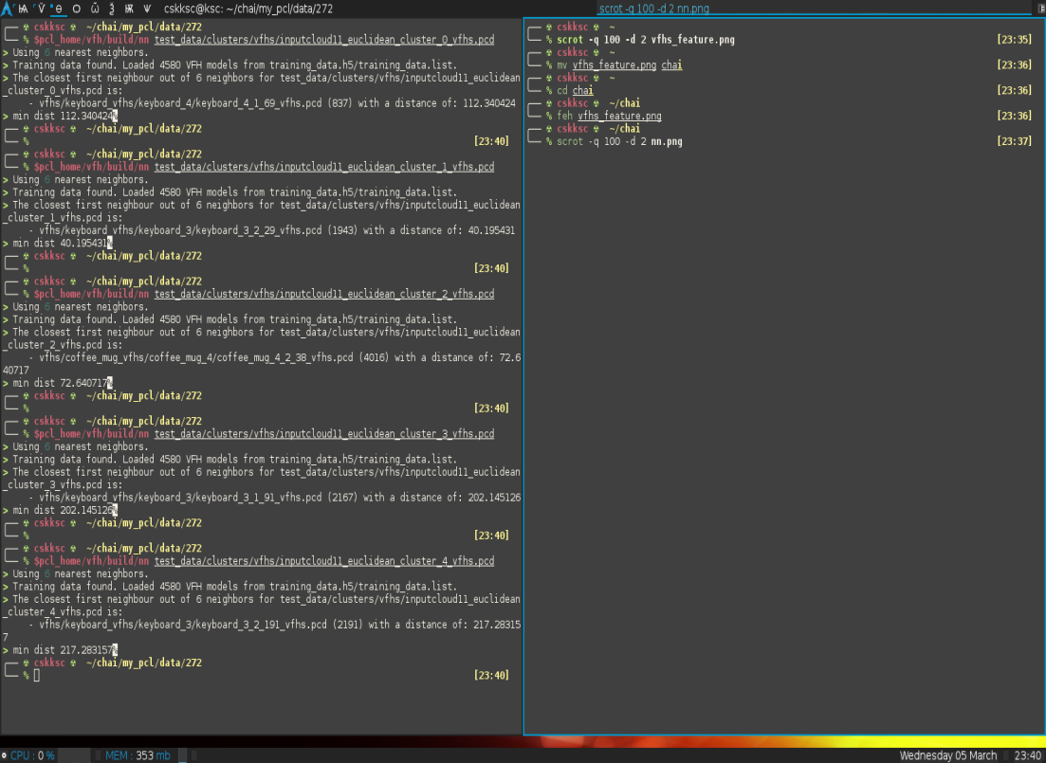
Step 6 : Feature comparison of individual segments with training set and segment with minimum distance determined

Slide 16
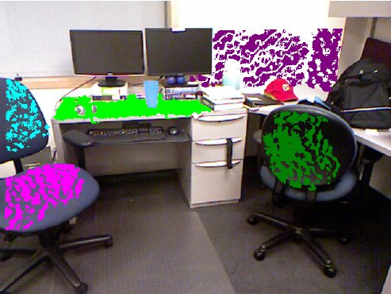

Slide 17
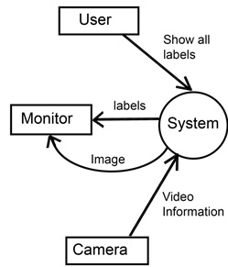
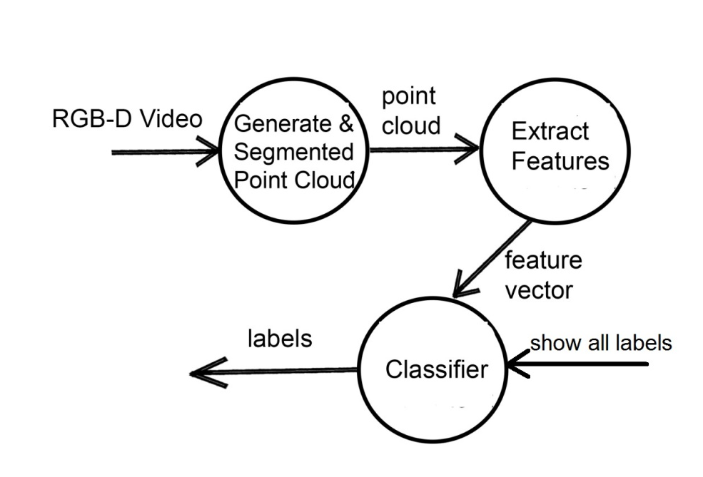
Data Flow Diagrams
Level 0 : Data Flow Diagram
Level 1 : Data Flow Diagram

